Slide 1

Technology vs. Business
By: Becca Buechle

Slide 2

Why a Balance Between Technology and Business is Important
There must be balance between technology and business is important when its driving decisions in an organization.
Technology can be very beneficial to a company, but it can also make things more difficult so finding the right balance is important.
Technology helps both the user and the industry by increasing things such as production, efficiency, automating some processes and by making communication easier.
Technology is here to stay so figuring out how to work with it is a must. Technology should be enabling change not driving it. (Higgins and Nicola Morini Bianzino, D.)
Technology can be either thought of as the product or the tool. As the product broad intuitive appeal. As the tool pragmatic efficient usage that doesn’t over complicate the business structure. There is also the redundancy to protect and secure business data.
Source: Joshi, R., & Afanasyev, D.

Slide 3
Sound Technology Decisions
Source: (Williams, A.)
When there are so many options out there today to choose from it can be difficult to know if you made the correct sound, long term choice for your business.
Where's a balance that needs to be upheld when making these choices about which technologies should be updated, replaced, or repaired. So how do you go about making sure that you are doing that?
When you start making these changes make sure that one of your top priorities is security.
Cybersecurity should be considered when making any change in a business. This is a big concern in the technology industry and can cause the company a lot of money if it isn’t thought about.
Even though you believe your company could never be at risk no one is ever immune from having some type of cyber attack happen. So the sooner you consider the importance of this the better off your company will be.
Always expect the best but also plan for the worst that could happen.
If your company isn’t using a backup system of some sort it is a must. You never know when you could have some type of system failure, a building fire, and so on. So having a backup is extremely important.

Slide 4
Sound Technology Decisions (continued)
Having a backup plan isn’t enough though your business needs to have a tried and true plan in place. A written-out policy and procedures that explains the expectations. This can be something such as a bring your own device policy so that things can be saved on those, but the policy must explain how employees can store and utilize any company information on these devices. But also use a provider you trust with also having a backup copy.
Consider the long-term cost of any changes
Are you not upgrading hardware or software now because its saving money? How much will it cost in the future if these things cause more issues?
Know where your company is vulnerable and any limitations you might have.
You should have quarterly vulnerability scanning's and annual penetration testing. Hackers are always looking for ways to get in. With any type of update or upgrade there's always that risk that something has changed enough that one could get in.
Be aware of current industry trends
Source: (Williams, A.)

Slide 5
Sound Technology Decisions (continued)
The cloud technology is becoming more and more popular this option really helps to increase accessibility, scalability and easy resource provisioning just a few reasons why its popular.
The cloud also allows for easy adjustment if you have an increase or even a decrease in business. 94% of businesses also said that they had better security once they switched to the cloud. (Williams, A.)
In a cloud or “as-a-Service” environment the infrastructure, software, and such are handled as a pay as you go type model. This can eliminate a huge cost since your company isn’t paying to have all its own hardware and software on site.
Education should also play a huge role in your company.
Employees are your greatest asset but can also but your greatest element of risk when it comes to technology and cybersecurity. Companies are only as secure as their employee's actions.
User error accounts for 95% of data breeches. (Williams, A.)
Guidelines for cybersecurity should never be a one and done type of thing. This is something that should be gone over frequently.
Source: (Williams, A.)

Slide 6
Guiding Principles of a Governance Model
Business Relevant – Are the technologies that are being chosen going to help advance the business outcome?
Actionable – Do these decisions align with the business strategy?
Long Lasting –The way you manage your company can have a big impact on communication and technology.
Source: (Joshi, R., & Afanasyev, D.)

Slide 7

Key Priorities
Helps to advance business and strategy alignment so that it doesn’t hold the company back
Helps speed up decision making
Helps improve value from investments in technology
Does it help advocate for global technology standards in your business?
Do these adjust quickly to a dynamic environment?
Are the risks your taking to add these new technologies good for your company?
Source: (Joshi, R., & Afanasyev, D.)

Slide 8

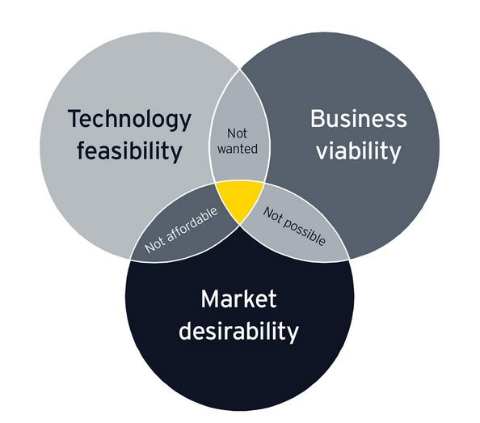



Technology Decisions
Source: (Joshi, R., & Afanasyev, D.)

Slide 9
Important Things to Consider When Making Technology Decisions
Market Desirability – Is this solution going to be valuable to the end customer?
Will our customers buy the finished product?
Business Viability – Is this going to be cost effective for the company?
How does this change affect our existing products and clients?
Technology Feasibility – Do we have all the rest of the needed technology to deliver the solution?
Do we have parts that we can reuse that will cut down costs?
Source: (Joshi, R., & Afanasyev, D.)

Slide 10
Bibliography
Higgins and Nicola Morini Bianzino, D. (2020, October 12). Tech Should Enable Change, Not Drive It. Retrieved October 28, 2020, from https://hbr.org/2020/10/tech-should-enable-change-not-drive-it
Joshi, R., & Afanasyev, D. (2020, July 22). How to make technology decisions for better business outcomes. Retrieved October 27, 2020, from https://www.ey.com/en_us/consulting/how-to-make-technology-decisions-for-better-business-outcomes
Williams, A. (2019, October 30). 8 Ways to Make Tech Decisions for Your Organization: Warren Averett. Retrieved October 27, 2020, from https://warrenaverett.com/insights/eight-ways-to-make-sound-technology-decisions-for-your-organization/

